Slide 1
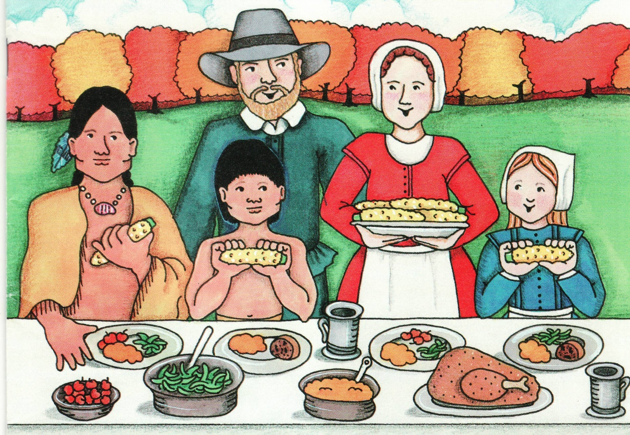
Wampanoag and Pilgrims:
Together They Were Better
Adapted from original by Joan Zatorski
Illustrator Felicity Frisbee

Slide 2
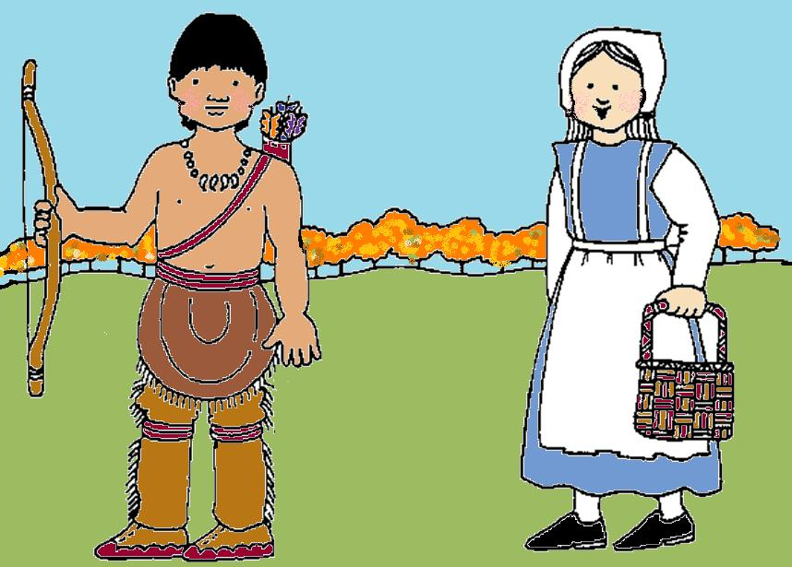
Long ago, two groups of very different people learned how important it was to work together and get along.

Slide 3
These people were the Wampanoag Indians and the Pilgrims. This is the story of how they helped each other.

Slide 4
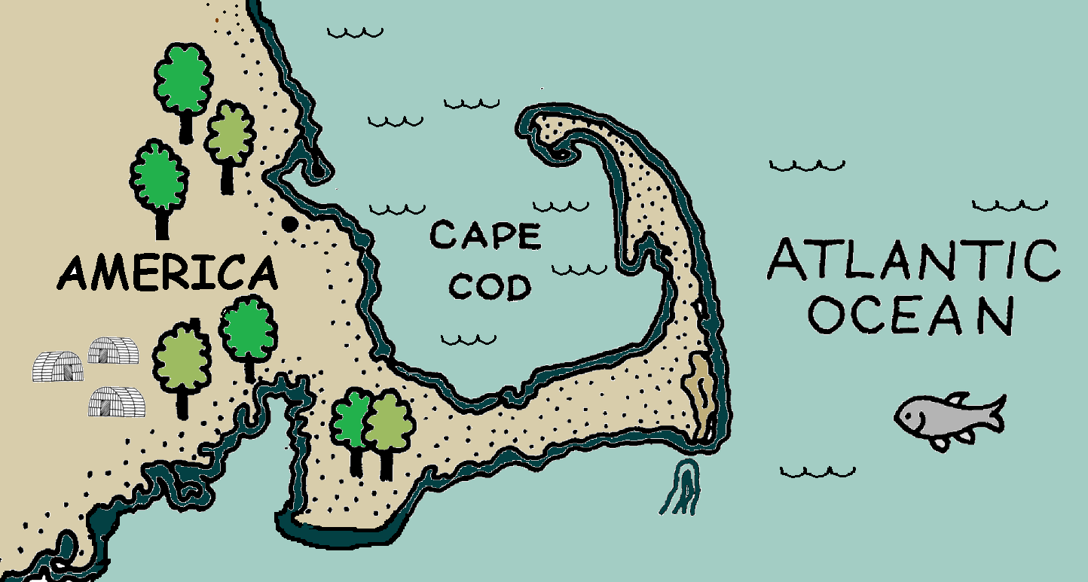
The Wampanoag Indians lived in America by the Atlantic Ocean.

Slide 5
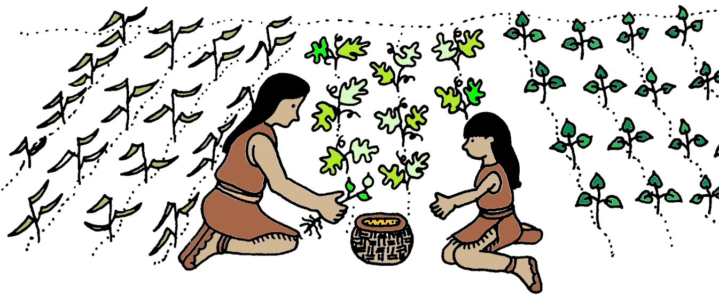
They were good farmers.

Slide 6
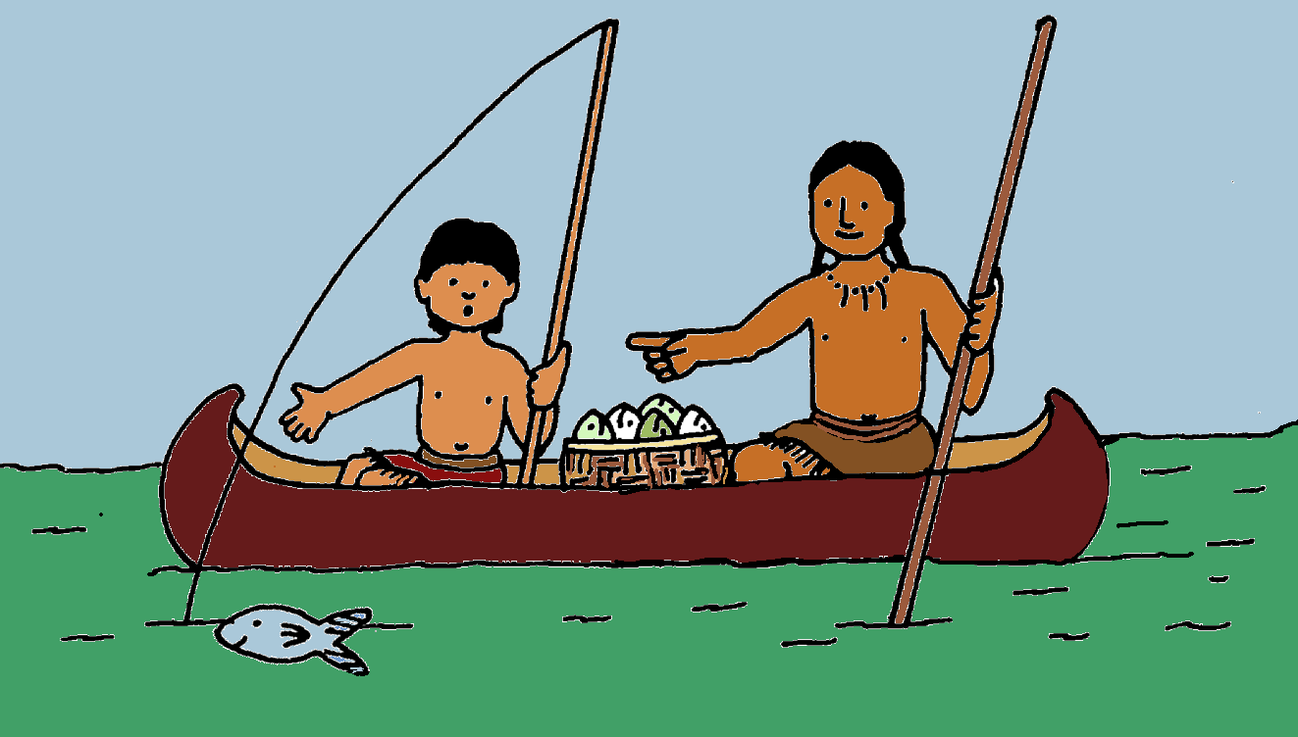
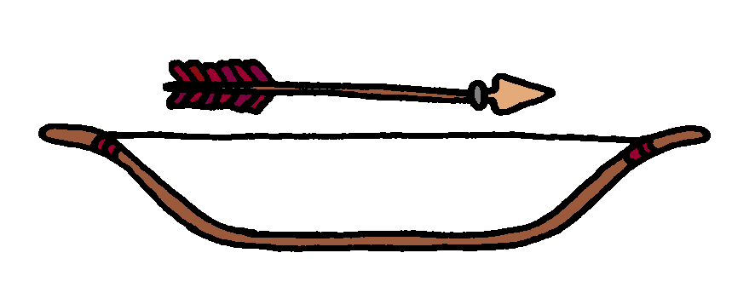
They were good fishermen and hunters.

Slide 7
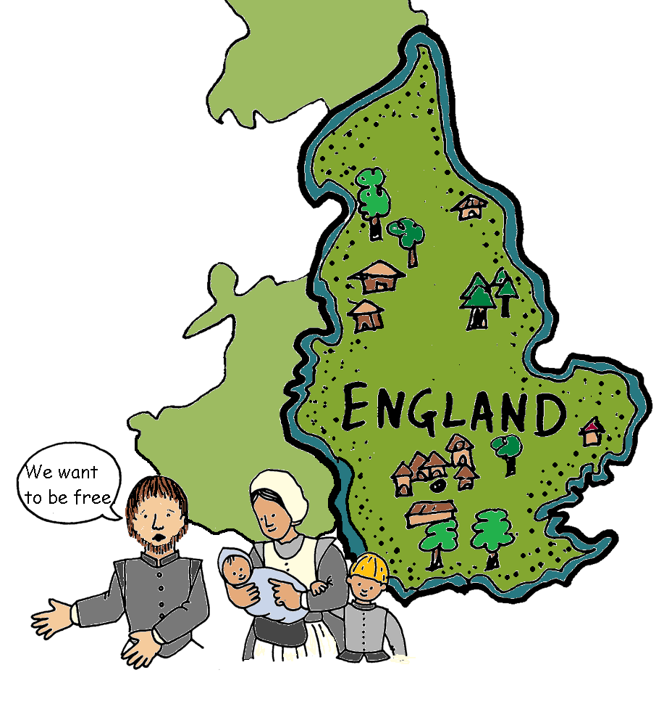
The Pilgrims lived in England. They were not happy living there.

Slide 8
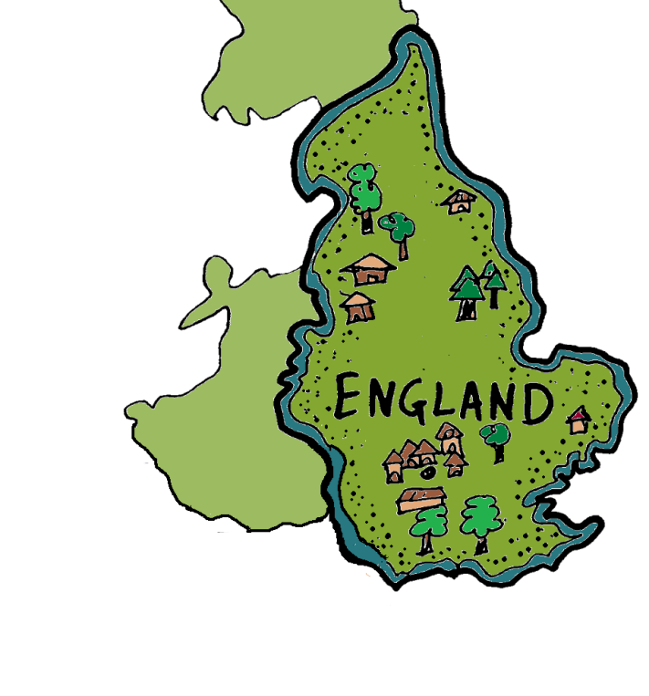
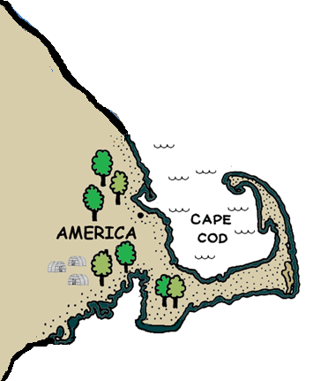
They did something very brave. In the fall of 1620, the Pilgrims sailed to a land they had not seen before.

Slide 9
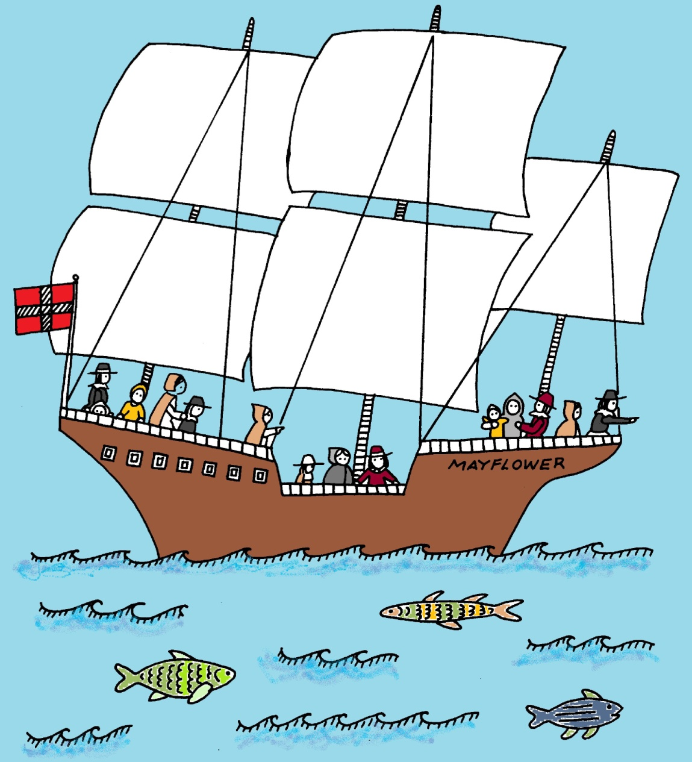
The Pilgrims sailed to America on a ship called the Mayflower.
It was a long and dangerous trip.

Slide 10
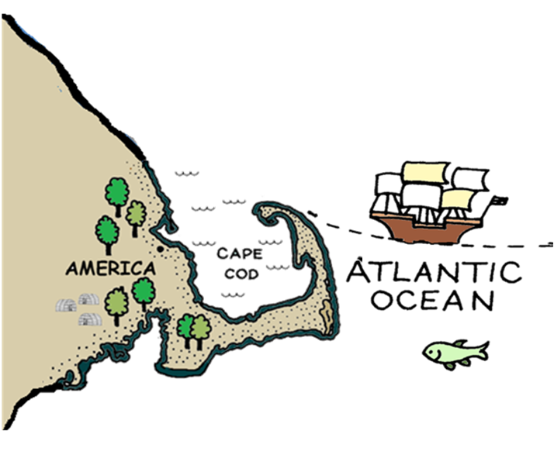
It was fall. The Pilgrims landed in America. This place was where the Wampanoag lived.

Slide 11
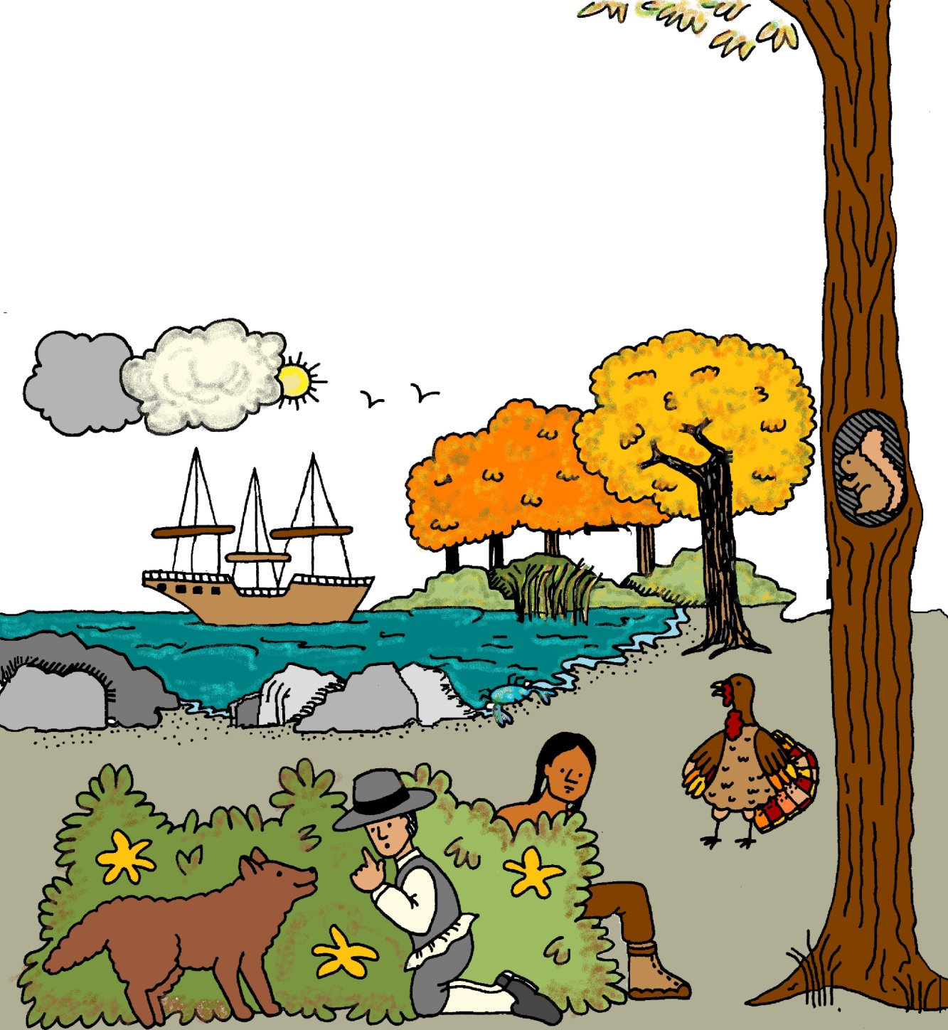
The Wampanoag worried about meeting the Pilgrims.
The Pilgrims worried about meeting the Wampanoag.

Slide 12
They looked different. They spoke different languages. They wore different clothes. They tried to hide from each other.

Slide 13
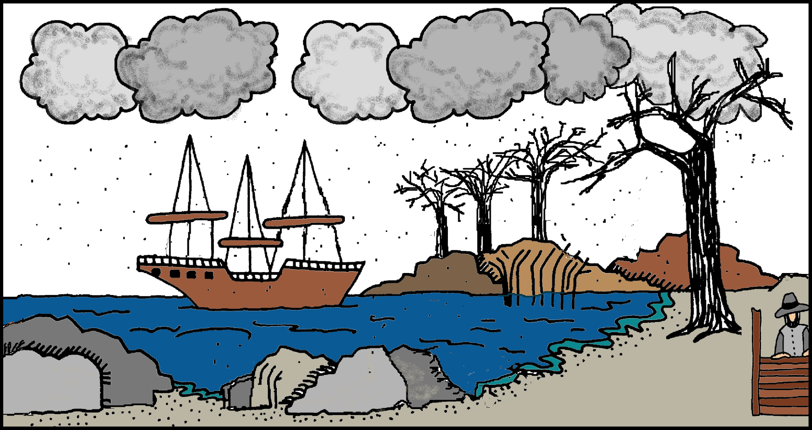
During the winter, the Pilgrims had a hard time in their new land. They did not have enough houses, food, or warm clothes.

Slide 14
The Pilgrims had to sleep on the ship until some houses were built. Many Pilgrims became ill and some died.

Slide 15
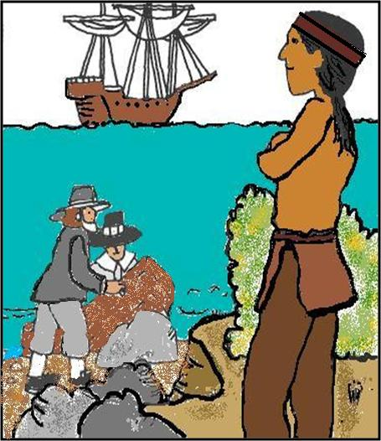
In the Spring, one Indian helped the Pilgrims. His name was Squanto.

Slide 16
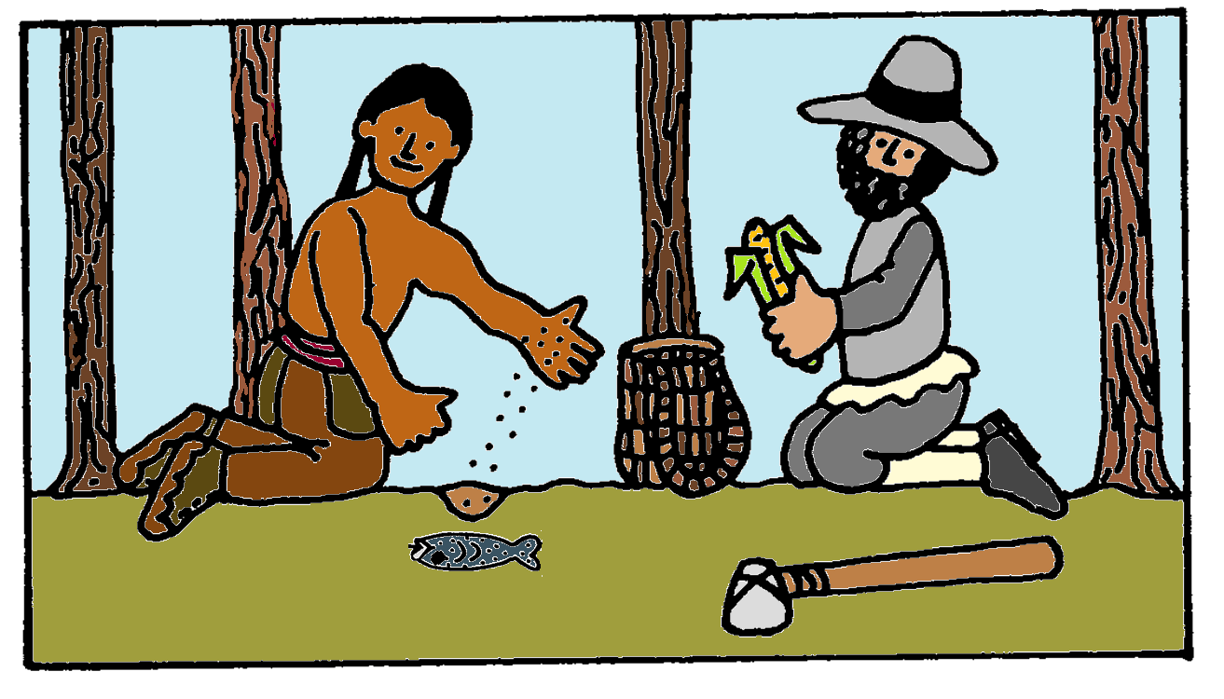
Squanto showed the Pilgrims how to plant corn using fish to help it grow.

Slide 17
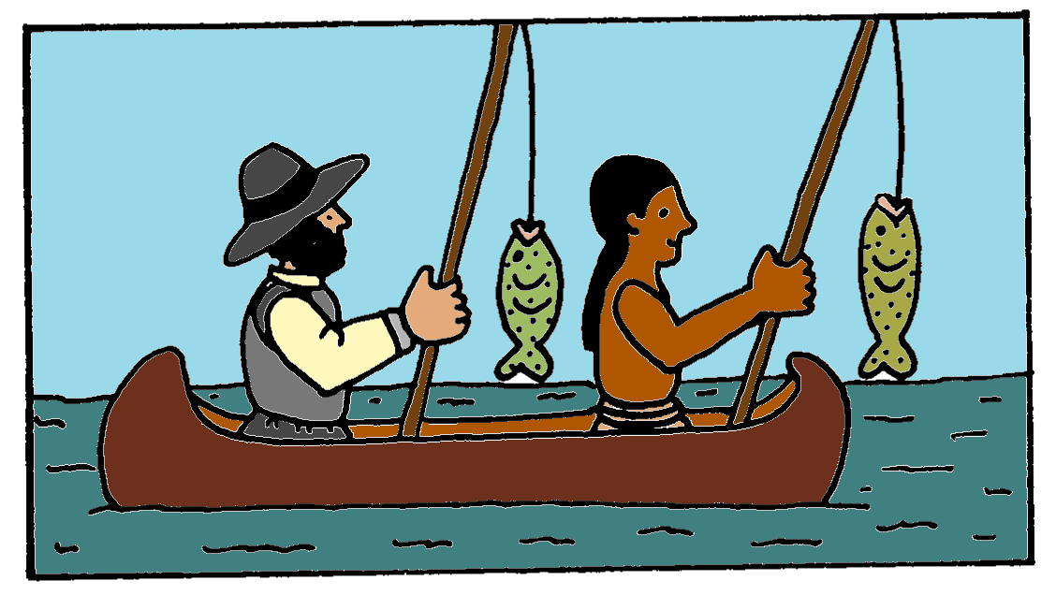
Squanto showed the Pilgrims how to fish.

Slide 18
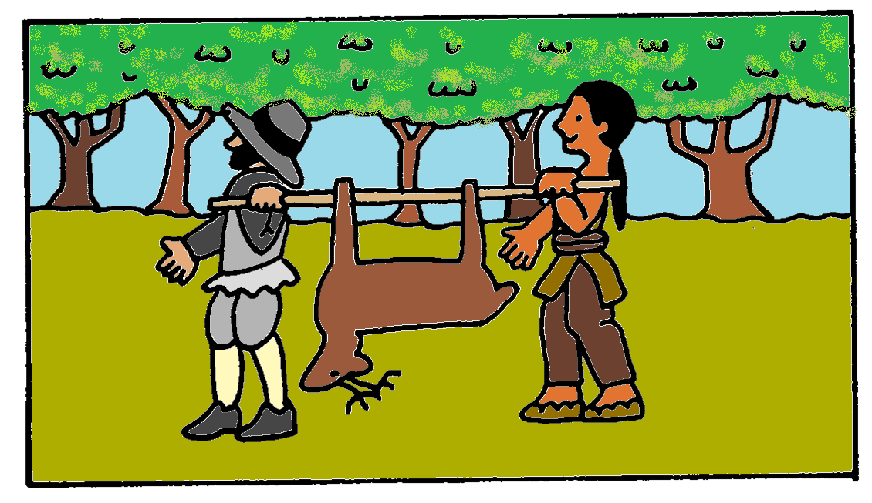
Squanto showed the Pilgrims how to hunt.

Slide 19
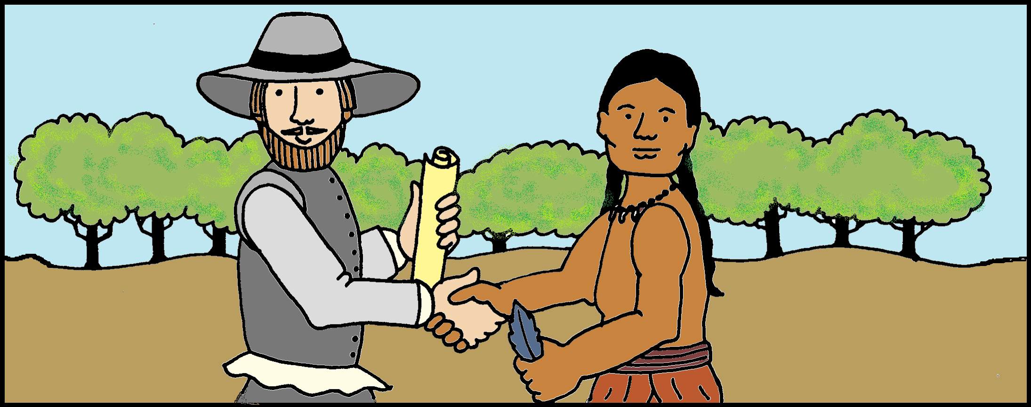
Soon other Wampanoags visited the Pilgrims. They signed a paper that said they would not harm each other.

Slide 20
The Wampanoag and Pilgrims learned not to fear each other. They began to work together to have better lives.

Slide 21
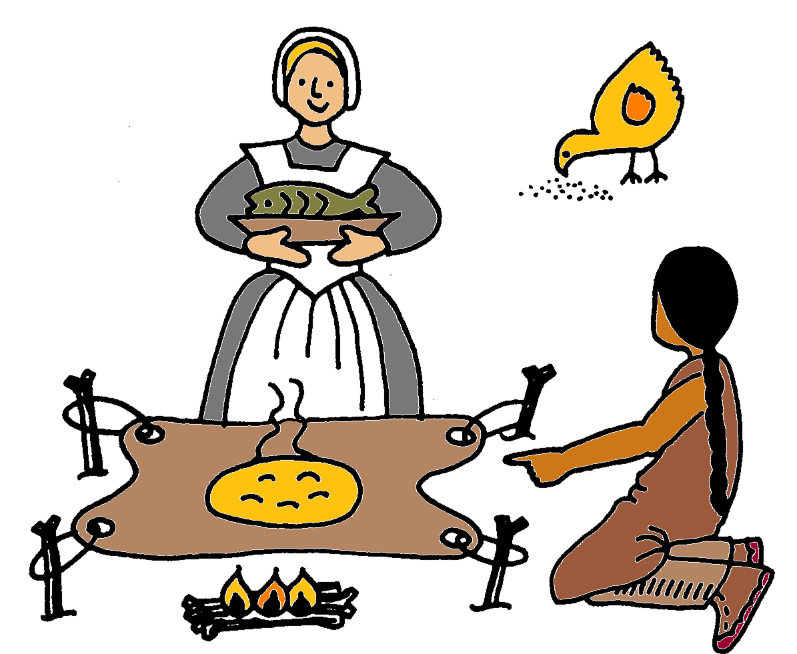
The Wampanoags showed the Pilgrims how to cook corn on the hide of a deer.

Slide 22
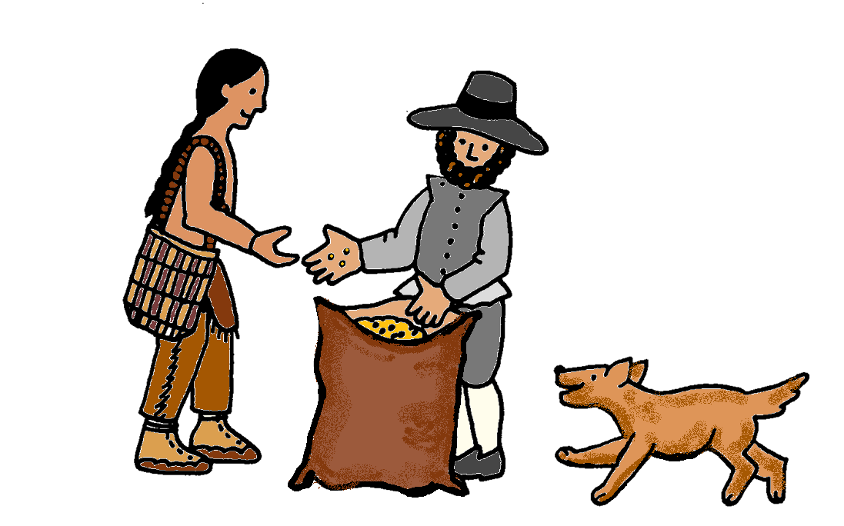
The Pilgrims gave the Wampanoags some seeds.

Slide 23
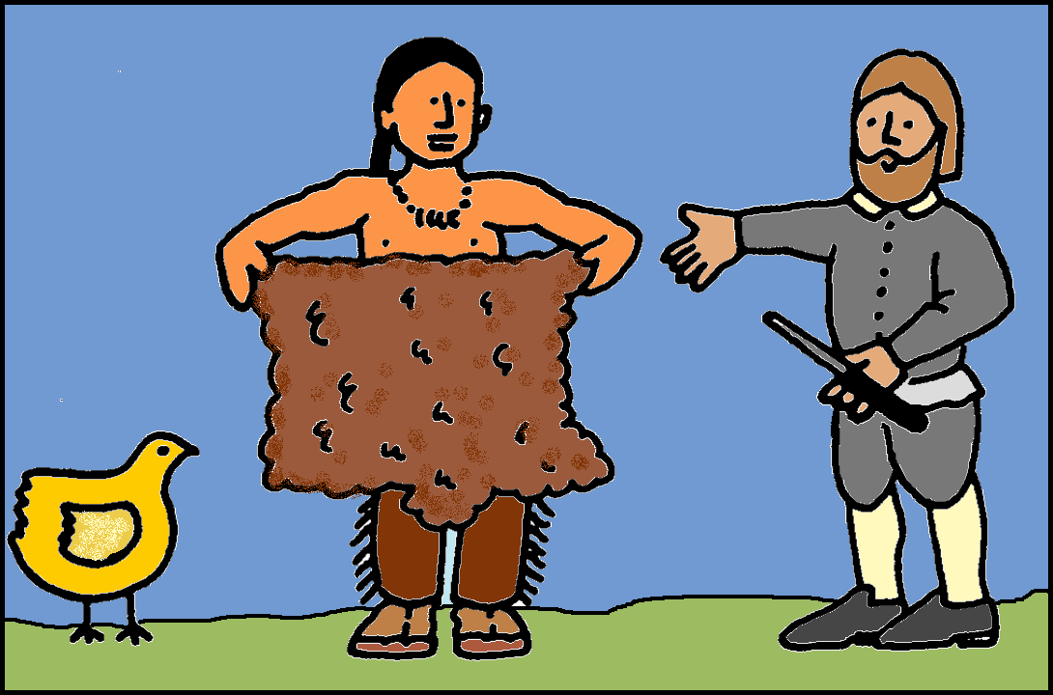
The Pilgrims and Wampanoags traded with each other.

Slide 24
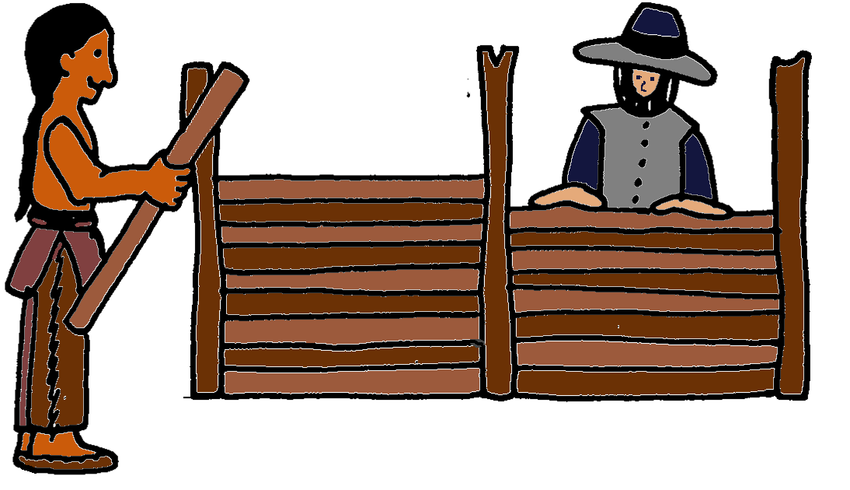
The Wampanoags helped the Pilgrims build cozy houses.

Slide 25
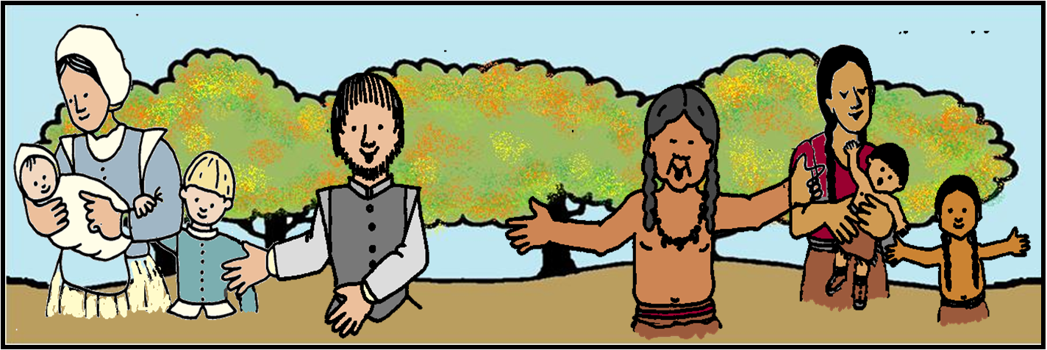
After summer was over, the Pilgrims had more food. They wanted to celebrate and have a feast. They invited the Wampanoags.

Slide 26
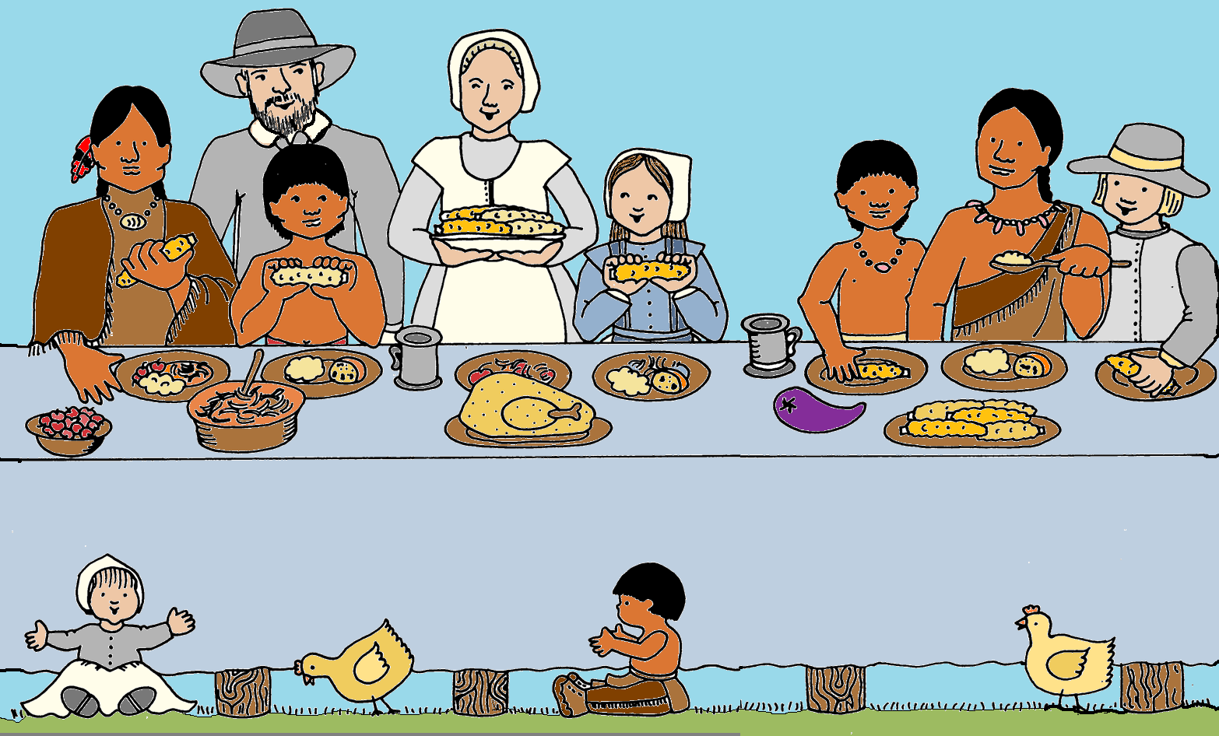
The Wampanoag brought deer and turkeys to share with the Pilgrims. The Pilgrims prepared bread, cheese, onions, fruit tarts, and fish for everyone.

Slide 27
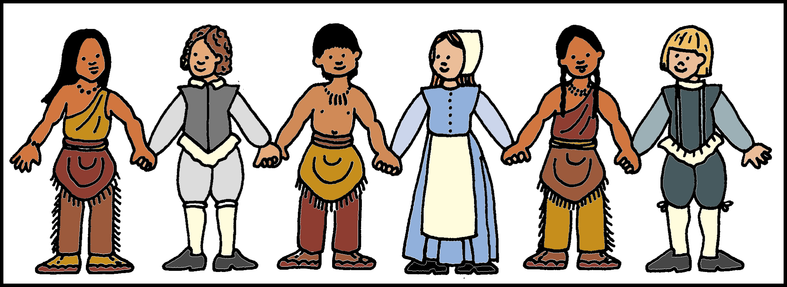
The Wampanoag and Pilgrims helped each other. Both of these people were better by working together.

